Slide 1
CEOS Working Group Calibration Validation WGCV
Land Product Validation Plenary, Virtual meeting, Teams,
26-27 May 2021
Akihiko KUZE, chair WGCV
Philippe Goryl, vice chari WGCV

Slide 2
CEOS
CEOS- 62 Agencies (34 Members & 28 Associates) operating 173 satellites
Providing leadership within CEOS
Powering and sustaining CEOS activities
Generating new and innovative ideas and initiatives
CEOS is the mechanism that brings these organisations together to collaborate on missions, data systems, and global initiatives that benefit society and align with their own Agency missions and priorities.
The number of Earth-observing satellites has vastly increased, Users needs, expectation evolve
COORDINATION
A central part of GEO: Global Earth Observation System of Systems (GEOSS)
CEOS – Space Arm of GEO

Slide 3
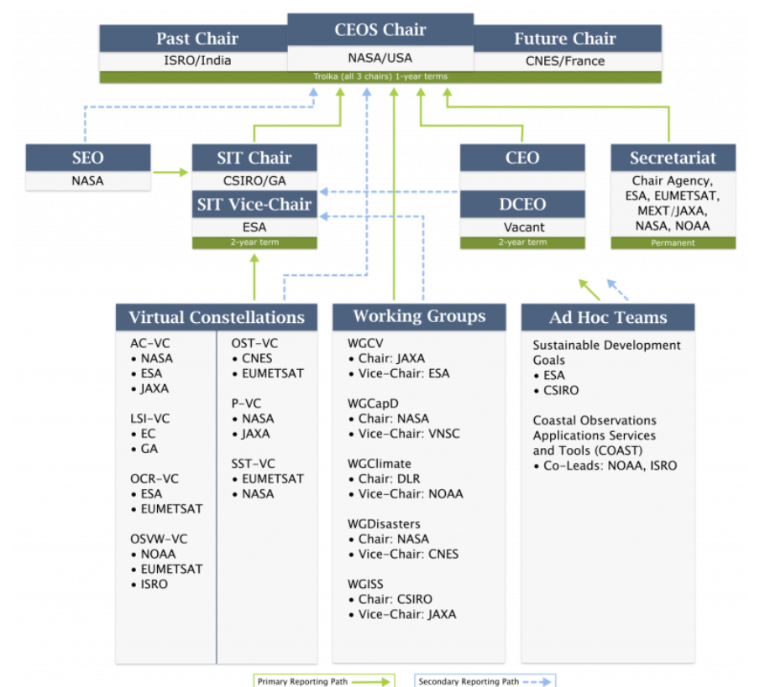
CEOS
CEOS relies on:
Working Groups
Virtual Constellation
Ad-Hoc Team
Interactions between
Groups are fundamental

Slide 4
The mission of the CEOS Working Group on Calibration & Validation (WGCV) is to ensure long-term confidence in the accuracy and quality of Earth Observation data and products and to provide a forum for the exchange of information about calibration and validation, including the coordination of cooperative activities. https://ceos.org/ourwork/workinggroups/wgcv/ http://calvalportal.ceos.org/
WGCV

Slide 5
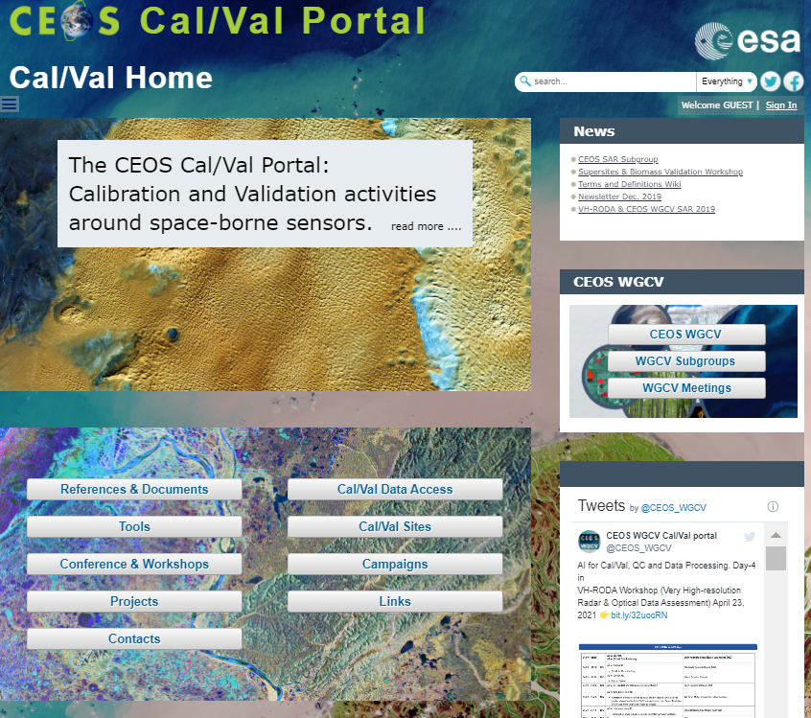
The mission of the CEOS Working Group on Calibration & Validation (WGCV) is to ensure long-term confidence in the accuracy and quality of Earth Observation data and products and to provide a forum for the exchange of information about calibration and validation, including the coordination of cooperative activities. https://ceos.org/ourwork/workinggroups/wgcv/ http://calvalportal.ceos.org/
WGCV

Slide 6
The CEOS Working Group on Calibration & Validation (WGCV) supports six Subgroups that operate as individual entities and focus on specific technical areas related to calibration and validation.
WGCV
WGCV Subgroups
The WGCV subgroups are as follows:
Atmospheric Composition (ACSG)
Infrared Visible Optical Sensors (IVOS)
Land Product Validation (LPV)
Microwave Sensors (MSSG)
Synthetic Aperture Radar (SAR)
Terrain Mapping (TMSG)

Slide 7
WGCV groups main interactions → interaction with WGISS – products contents / formats / definition / quality information / Data Cube / ARD → Interaction VC: support for CARD4L assessment, support on Cal/Val information → Interaction ad-hoc groups: support regarding Cal/Val, Uncertainties estimation, Climate Change GHG roadmap
WGCV
WGCV Interaction / coordination with WMO / GSICS

Slide 8
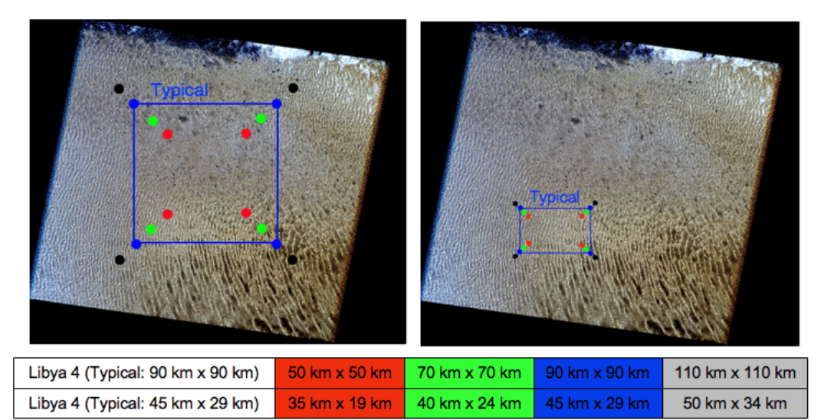
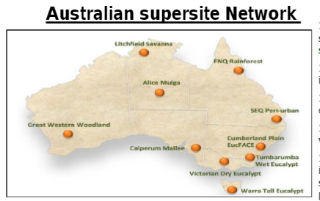
WGCV – achievement example
WGCV provides References
Radiometric Calibration Network (RadCalNet):
Provides satellite operators with Top-of-Atmosphere (TOA) spectrally-resolved reflectances to aid in post-launch radiometric cal/val of optical imaging sensor data.
Numbers of RadCalNet sites and users are growing.
Vicarious Calibration Methods and sites
Pseudo-Invariant Calibration Site – PICS catalog
DCC,
Rayleigh,
Glint
Super site Validation
LST
Vegetation
Soil Moisture
….etc…

Slide 9
WGCV – achievement example
WGCV provides
References
Super site Validation
LST
Vegetation
Soil Moisture
….etc…
Vicarious Calibration Methods and sites
Pseudo-Invariant Calibration Site – PICS catalog
DCC,
Rayleigh,
Glint
FRM
Solar Irradiance
Radiometric Calibration Network (RadCalNet):
Provides satellite operators with Top-of-Atmosphere (TOA) spectrally-resolved reflectances to aid in post-launch radiometric cal/val of optical imaging sensor data.
Numbers of RadCalNet sites and users are growing.

Slide 10
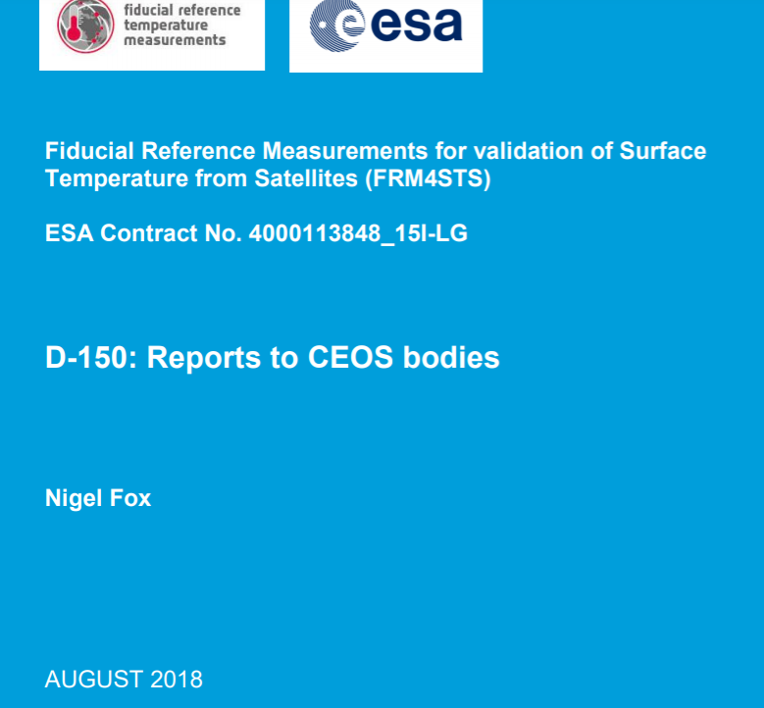
WGCV – achievement example
WGCV provides Protocols (list not exhaustive)
Biomass Validation Protocols
Soil Moisture
LST
Albedo
LAI
GHG
SST
Ocean Colour
…..

Slide 11
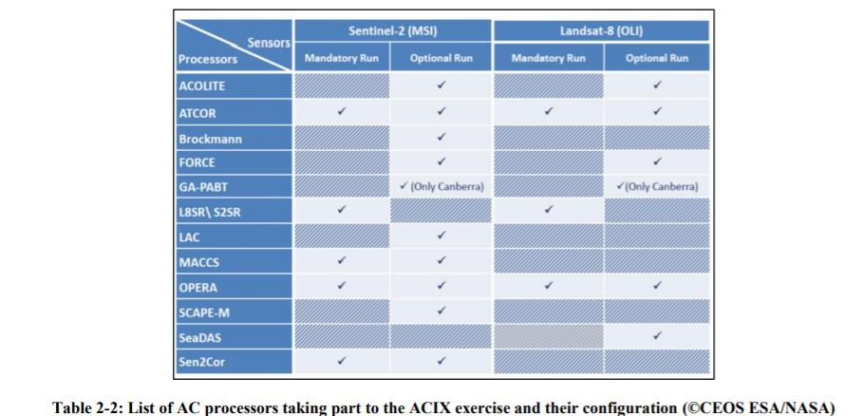
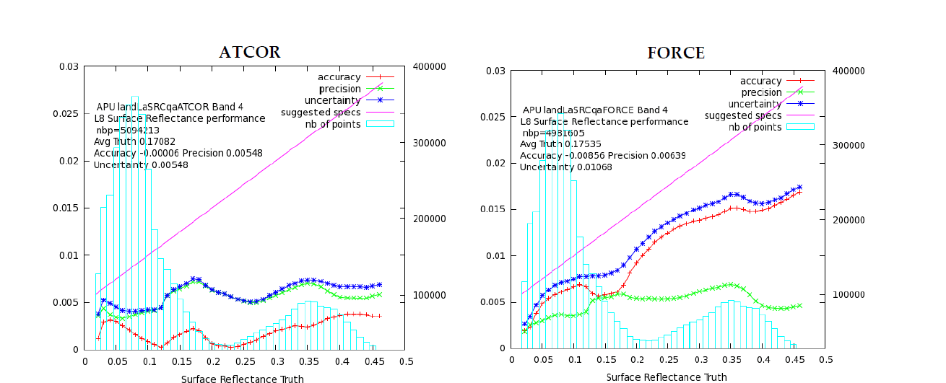
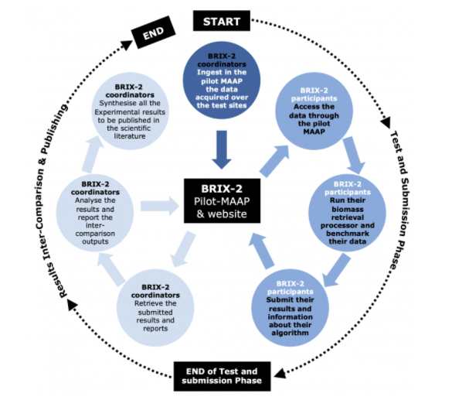
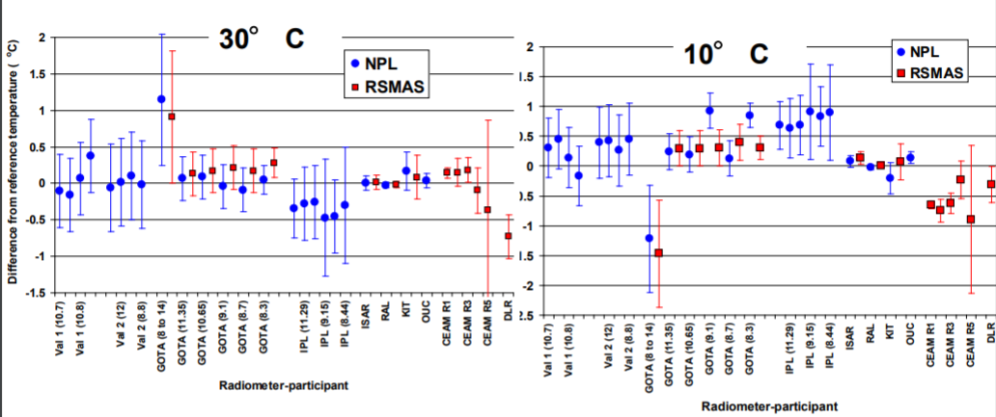
WGCV – achievement example
WGCV provides intercomparison framework
ACIX
CMIX
DEMIX
BRIX
SRIX4VEG
FM4STS
FRM4OC
GHG

Slide 12
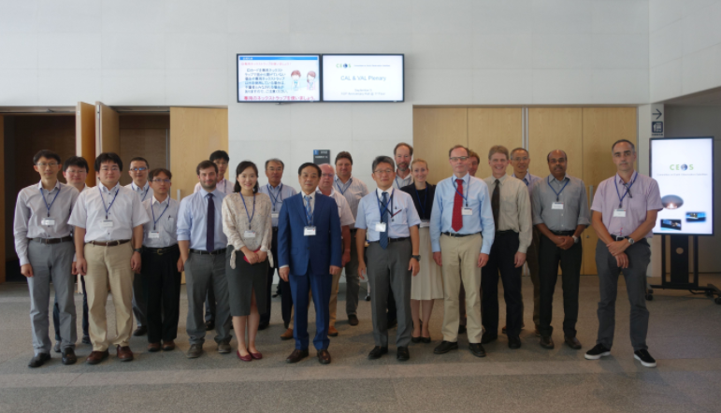
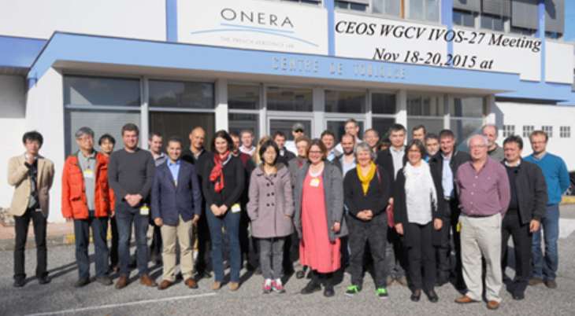
Coordination / communication
Japan, 2016
Regular WGCV Meeting
Thematic Meeting (ACIX, RadCalNet…etc…)
Thematic Workshop (ex: Pre-flight calibration CEOS/GSICS workshop)
Regular Report to CEOS SIT and Plenary
Report to GSICS
France, 2015, With IVOS and RadCalNet

Slide 13
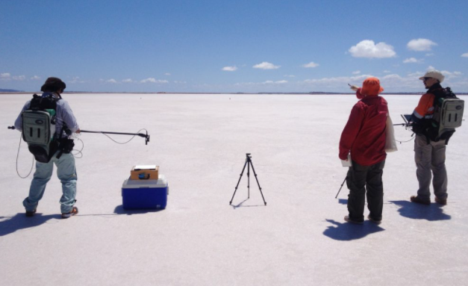
Conclusion
WGCV central role within CEOS
WGCV instrumental to “implement” QA4EO
WGCV relies on subgroups
WGCV provides references and guideline and expertise
Communication/interaction is fundamental (within WGCV, within CEOS, with GSICS)

Slide 14
THANK YOU …

